Slide 1
Employee Data Analysis using Excel
STUDENT NAME:S.Hemamalini
REGISTER NO:312220246
DEPARTMENT:BCOM GENERAL
COLLEGE JEPPIAAR COLLEGE OF ARTS AND SCIENCE

Slide 2
PROJECT TITLE
Employee Performance Analysis using Excel

Slide 3


AGENDA
Problem Statement
Project Overview
End Users
Our Solution and Proposition
Dataset Description
Modelling Approach
Results and Discussion
Conclusion
3/21/2024 Annual Review

Slide 4

PROBLEM STATEMENT
The organization currently lacks a standardized and efficient method to analyze and visualize employee performance data. Existing processes for performance evaluation are manual, time-consuming, and prone to errors, leading to incomplete or inaccurate assessments.

Slide 5

PROJECT OVERVIEW
The primary objective of this project is to design and implement an Excel-based tool for analyzing and visualizing employee performance data.
The project will involve gathering relevant employee performance data, structuring this data in Excel, and applying analytical techniques to generate insights.

Slide 6

WHO ARE THE END USERS?
The end users of an employee performance analysis using Excel typically include: Human Resources (HR) Department
Department Managers and Team Leaders
Senior Management and Executives
Performance Review Committees:

Slide 7

OUR SOLUTION AND ITS VALUE PROPOSITION
The project will involve the creation of an Excel-based performance analysis tool that will:
Integrate data
Analyze Performance
Visualize Data
Facilitate Reporting

Slide 8
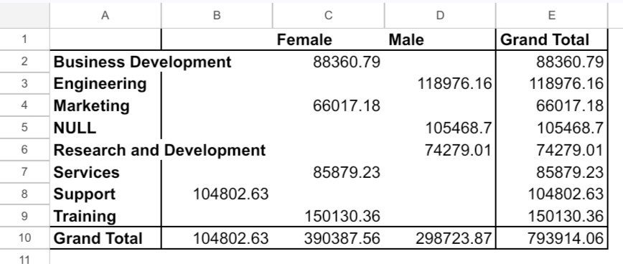
Dataset Description

Slide 9
MODELLING
Tools and Techniques in Excel:
Pivot Tables: For summarizing and analyzing data across different dimensions such as department, job title, or performance ratings.
Charts and Graphs: To visualize trends, distributions, and correlations within the dataset.
Formulas: Use Excel functions like VLOOKUP, SUMIFS, and AVERAGEIFS to perform calculations and derive additional insights from the data.
9

Slide 10
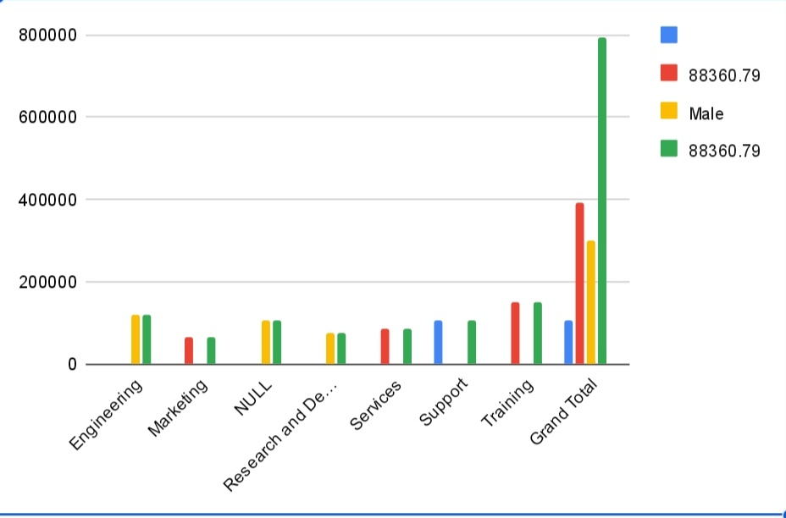
RESULTS
10

Slide 11
conclusion
In conclusion, the employee data analysis project using Excel has provided a comprehensive overview of workforce patterns, performance metrics, and demographic trends within the organization.
Through the use of Excel’s functionalities—such as pivot tables, charts, and data visualization tools—we were able to identify key insights, including areas of strength and opportunities for improvement.

